Slide 1
Simple Machines: Screws, wheels and pulleys
Year 7 Science

Slide 2

Review: Inclined plane or lever?

Slide 3

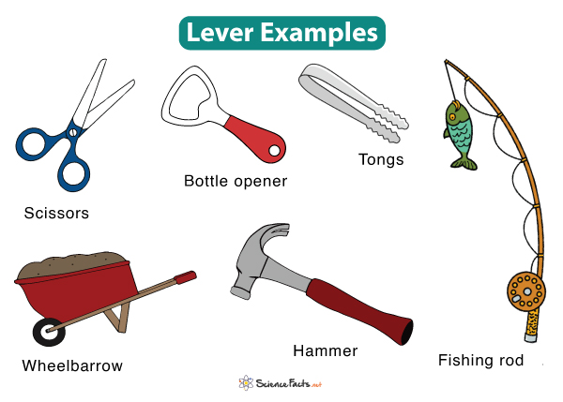
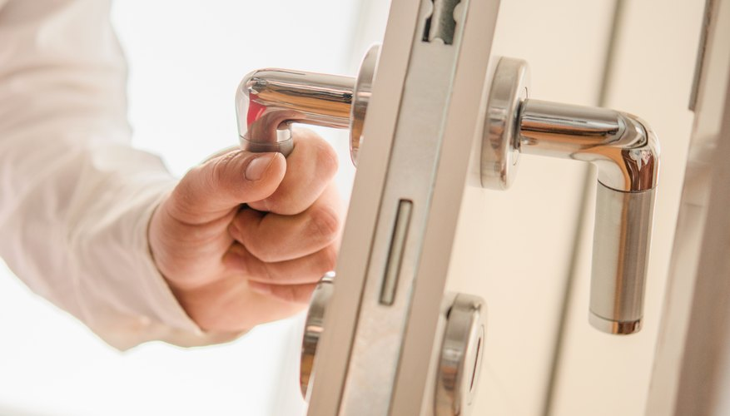


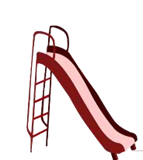
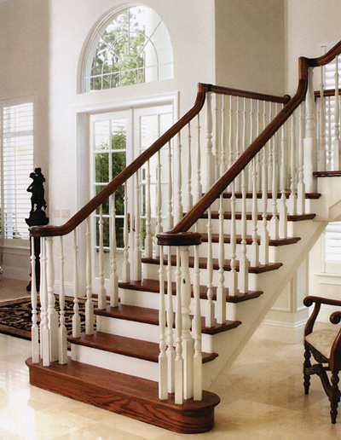
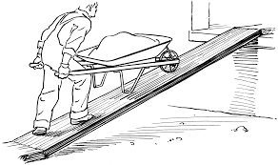
Review: Inclined plane or lever?

Slide 4
Learning Intentions
Investigating a simple machine such as lever or pulley system

Slide 5
Success criteria
Explain that a simple machine works by reducing the force but increasing the distance.
Explain mechanical advantage.
Use wheels and axles and pulleys as an example of simple machines.
Complete your investigation.

Slide 6


Slide 7
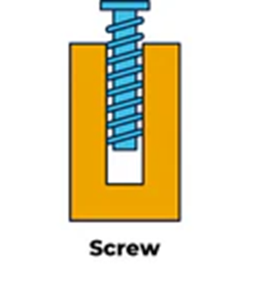
Where is the mechanical advantage?

Slide 8
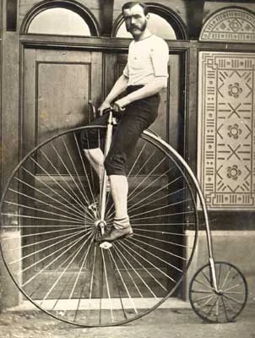
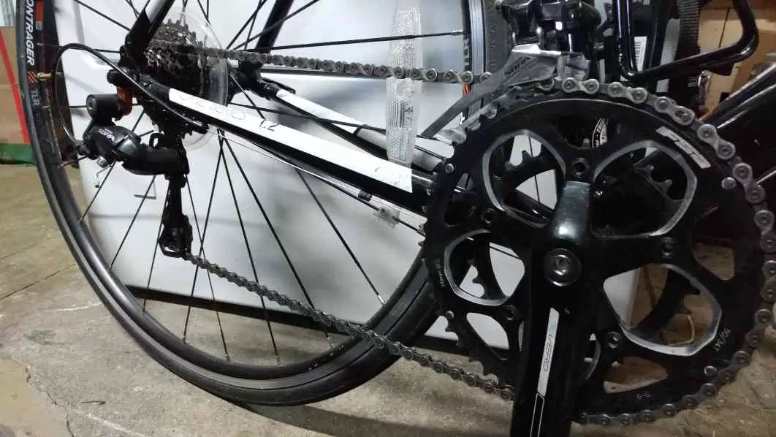
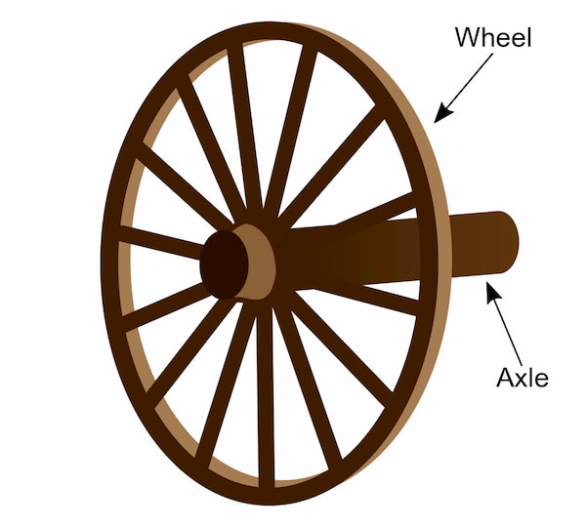
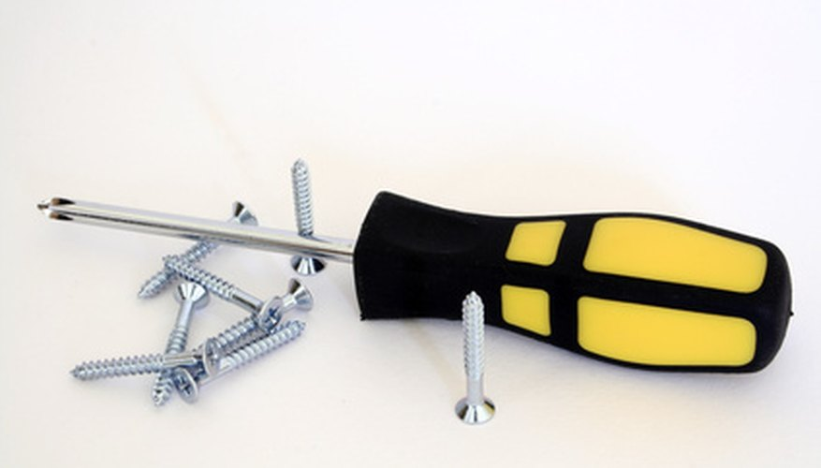
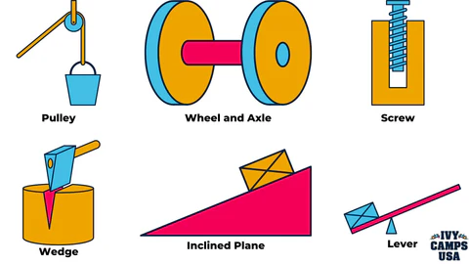
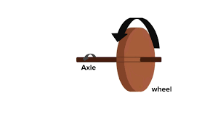
Where is the mechanical advantage?

Slide 9
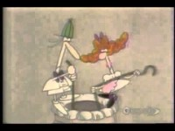

Slide 10


Where is the mechanical advantage?
Effort
Load

Slide 11
Things to work on today
Graph your investigation
Complete validation questions for your investigation (test conditions)
Pulleys Worksheet and Experiment
Simple machines sorter
(cut and paste, sort, colour)

Slide 12
Success criteria
Explain that a simple machine works by reducing the force but increasing the distance.
Explain mechanical advantage.
Use wheels and axles and pulleys asan example of simple machines.
Complete your investigation.

